Slide 1

Image captioning
Computer vision
Final project
522K0031 – Pham Thai An Binh
522K0038 – Nguyen Nhat Khoa

Slide 2



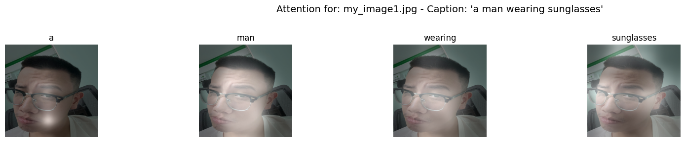
What is Image Captioning?
Generating a natural language description for a given image
Accessibility, Image Retrieval, Human and AI Interaction, Robotics
Translating visual scenes into coherent sentences

Slide 3
Limitations of Earlier Approaches
Deep Networks
Input
Image features
Prediction

Slide 4
Deep Networks
Attention
Input
Input
Covering Detector
Regions of interest
Image features
Object feature
Gender features
Action features
Prediction
Compute saliency
Prediction

Slide 5

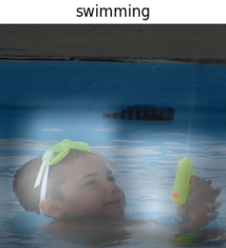
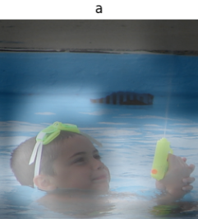
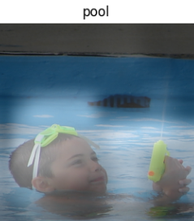


The Core idea of “Show, Attend and tell”
Main Contribution of paper
Introduced attention-based mechanism
Model dynamically focuses on important regions of an image.

Slide 6
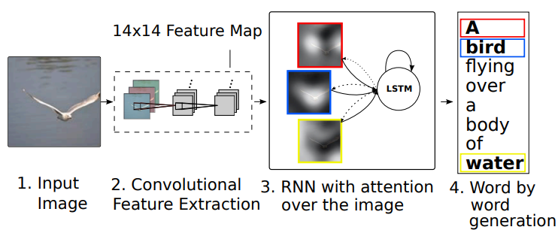
How the Attention Mechanism Works
Objective: To determine the most relevant image regions for generating each word in the caption.

Slide 7
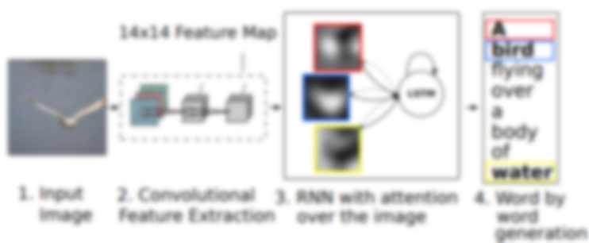
How the Attention Mechanism Works
Objective: To determine the most relevant image regions for generating each word in the caption.
1. An image encoder (CNN) processes the input image. It outputs a grid of feature vectors

Slide 8
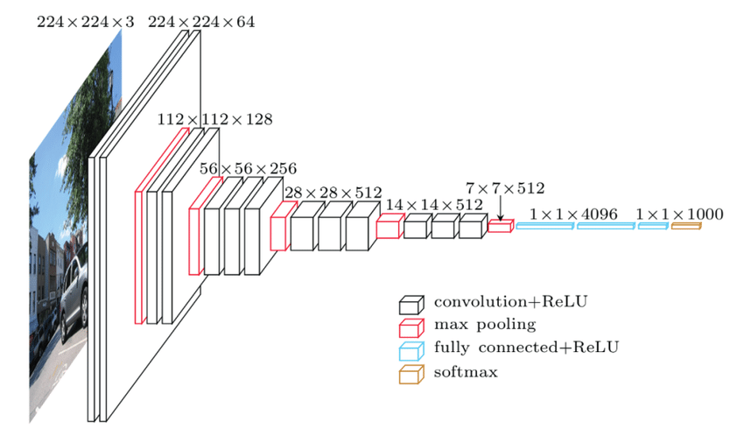
CNN Encoders(VGGNet)

Slide 9
CNN Encoders(VGGNet)
Purpose: The CNN's role is to transform the input image into a rich, spatially organized set of features that the attention mechanism can later use.

Slide 10
CNN Encoders(VGGNet)
VGGNet processes an input image (ex: 224x224x3) through a series of convolutional layers and max-pooling layers.

Slide 11
CNN Encoders(VGGNet)
VGGNet processes an input image (ex: 224x224x3) through a series of convolutional layers and max-pooling layers.
Convolutional layers extract features, and max-pooling layers reduce the spatial dimensions

Slide 12
CNN Encoders
Key for Attention: Instead of using the final classification layers , the "Show, Attend, and Tell" paper extracts features from an earlier convolutional layer.

Slide 13

CNN Encoders
Key for Attention: Instead of using the final classification layers , the "Show, Attend, and Tell" paper extracts features from an earlier convolutional layer.

Slide 14
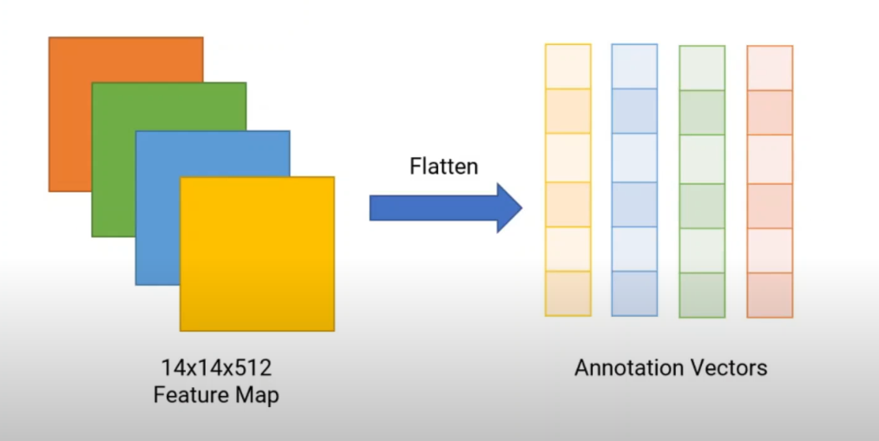
From Feature Map to Annotation Vectors

Slide 15
From Feature Map to Annotation Vectors
*Flatten: transforming a matrix into a single, long list or one-dimensional array

Slide 16
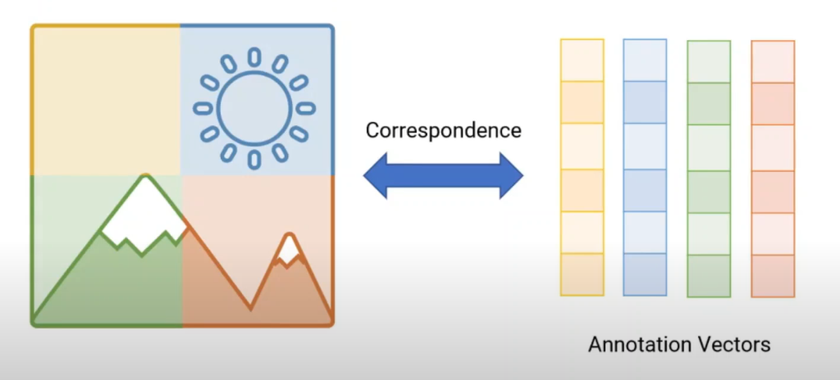
From Feature Map to Annotation Vectors

Slide 17
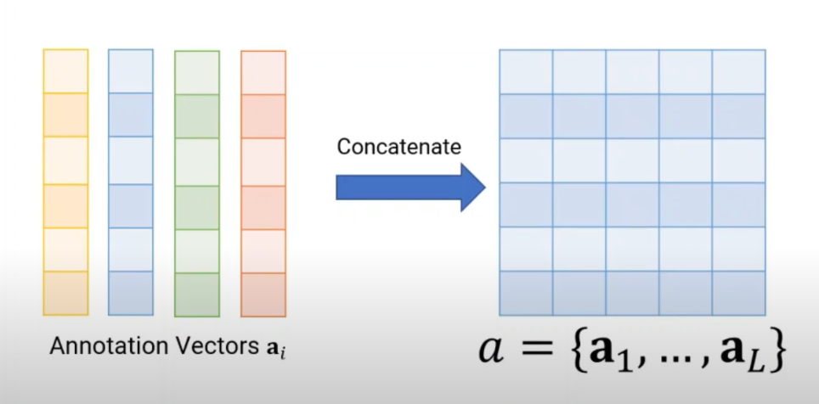
From Feature Map to Annotation Vectors

Slide 18
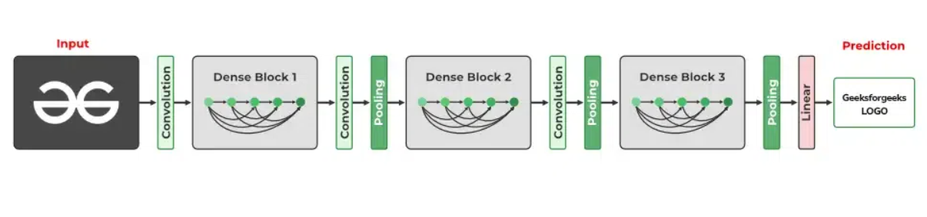
CNN Encoders(DenseNet-205)

Slide 19
CNN Encoders(DenseNet-205)

Slide 20
How the Attention Mechanism Works
Objective: To determine the most relevant image regions for generating each word in the caption.
An image encoder (CNN) processes the input image. It outputs a grid of feature vectors

Slide 21

How the Attention Mechanism Works
Objective: To determine the most relevant image regions for generating each word in the caption.
An image encoder (CNN) processes the input image. It outputs a grid of feature vectors
At each step, the RNN uses its hidden state to assess the relevance of each 14×14 Feature Map region,..

Slide 22
How the Attention Mechanism Works
Objective: To determine the most relevant image regions for generating each word in the caption.
An image encoder (CNN) processes the input image. It outputs a grid of feature vectors
At each step, the RNN uses its hidden state to assess the relevance of each 14×14 Feature Map region, calculating attention weights. These weights then form a context vector.

Slide 23
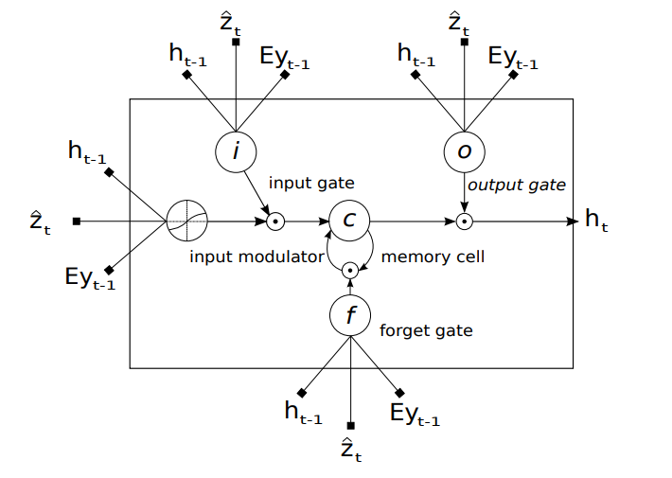
Decoder: The LSTM Architecture

Slide 24
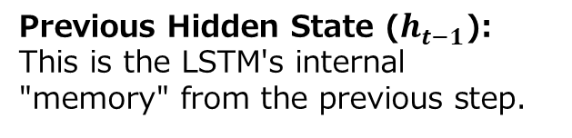
Decoder: The LSTM Architecture
Previous Hidden State ($h_{t−1}$): This is the LSTM's internal "memory" from the previous step.

Slide 25
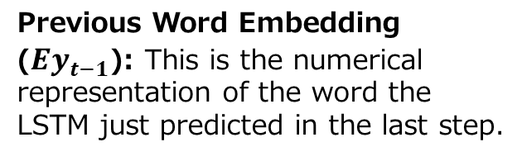
Decoder: The LSTM Architecture
Previous Hidden State ($h_{t−1}$): This is the LSTM's internal "memory" from the previous step.
Previous Word Embedding ($Ey_{t−1}$): This is the numerical representation of the word the LSTM just predicted in the last step.

Slide 26
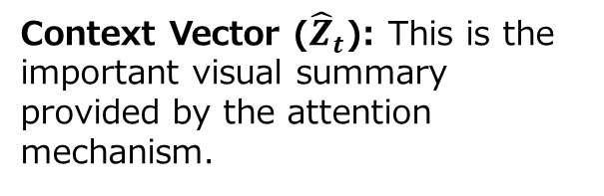
Decoder: The LSTM Architecture
Previous Hidden State ($h_{t−1}$): This is the LSTM's internal "memory" from the previous step.
Previous Word Embedding ($Ey_{t−1}$): This is the numerical representation of the word the LSTM just predicted in the last step.
Context Vector (${\hat{Z}}_{t}$​): This is the important visual summary provided by the attention mechanism.

Slide 27
Decoder: The LSTM Architecture
The LSTM has special internal "gates" (like input gate, forget gate, output gate) and a "memory cell" (c)

Slide 28
Decoder: The LSTM Architecture
The LSTM has special internal "gates" (like input gate, forget gate, output gate) and a "memory cell" (c) :
Forget Gate (f): Decides what to throw away from the previous cell state.
Input Gate (i): Decides what new information to store in the cell state.
Output Gate (o): Decides what parts of the current cell state to output as the hidden state.

Slide 29
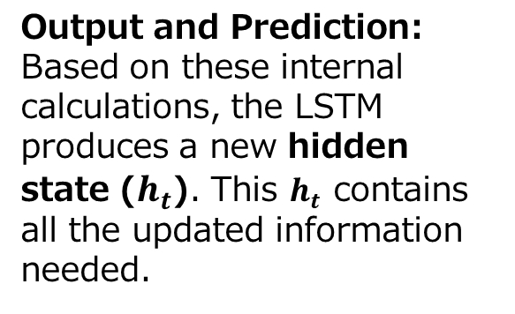
Decoder: The LSTM Architecture
Output and Prediction: Based on these internal calculations, the LSTM produces a new hidden state ($h_{t}$​). This $h_{t}$​ ​contains all the updated information needed.

Slide 30

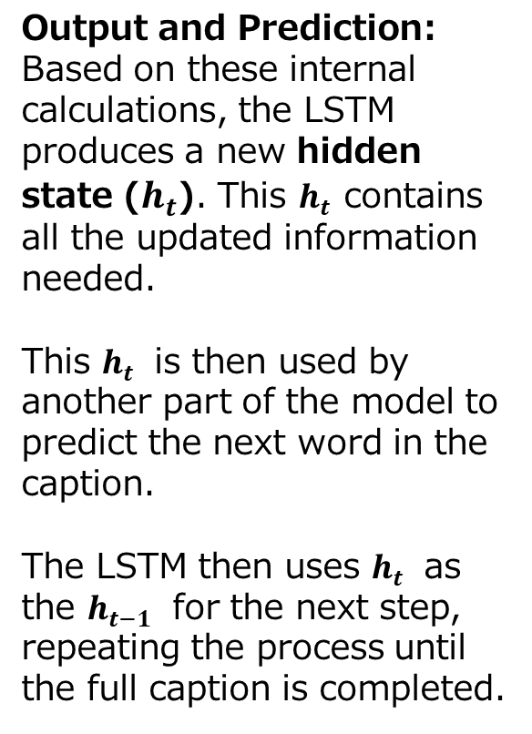
Decoder: The LSTM Architecture
Output and Prediction: Based on these internal calculations, the LSTM produces a new hidden state ($h_{t}$​). This $h_{t}$​ ​contains all the updated information needed.
This $h_{t}$​ is then used by another part of the model to predict the next word in the caption.
The LSTM then uses $h_{t}$​ as the $h_{t−1}$​ for the next step, repeating the process until the full caption is completed.

Slide 31
Decoder: The LSTM Architecture

Slide 32
Decoder: The LSTM Architecture
Preparing New Information to Potentially Add to Memory:
a . Input Modulator:
Processes the inputs (using a tanh activation function) to create a vector of candidate values

Slide 33
Decoder: The LSTM Architecture
Preparing New Information to Potentially Add to Memory:
a . Input Modulator:
Processes the inputs (using a tanh activation function) to create a vector of candidate values
b. Input Gate (i):
The input gate calculates a filter, values are between 0 and 1.

Slide 34
Decoder: The LSTM Architecture
Preparing New Information to Potentially Add to Memory:
a . Input Modulator:
Processes the inputs (using a tanh activation function) to create a vector of candidate values
b. Input Gate (i):
The input gate calculates a filter, values are between 0 and 1.
The output of the input modulator (is then element-wise multiplied by the output of the input gate to get new information

Slide 35
Decoder: The LSTM Architecture
2. Deciding What to Forget from Old Memory:
Forget Gate (f):
The same three core inputs are also fed into the forget gate. The forget gate calculates another filter.

Slide 36
Decoder: The LSTM Architecture
2. Deciding What to Forget from Old Memory:
Forget Gate (f):
The same three core inputs are also fed into the forget gate. The forget gate calculates another filter.

Slide 37
Decoder: The LSTM Architecture
3. Updating the Main Memory Cell ©
First, the old memory from the previous time step is element-wise multiplied by the output of the forget gate .This is the "forgetting" step.

Slide 38
Decoder: The LSTM Architecture
3. Updating the Main Memory Cell ©
First, the old memory from the previous time step is element-wise multiplied by the output of the forget gate .This is the "forgetting" step.
Then, the filtered new information is added to the result of the forgetting step.

Slide 39
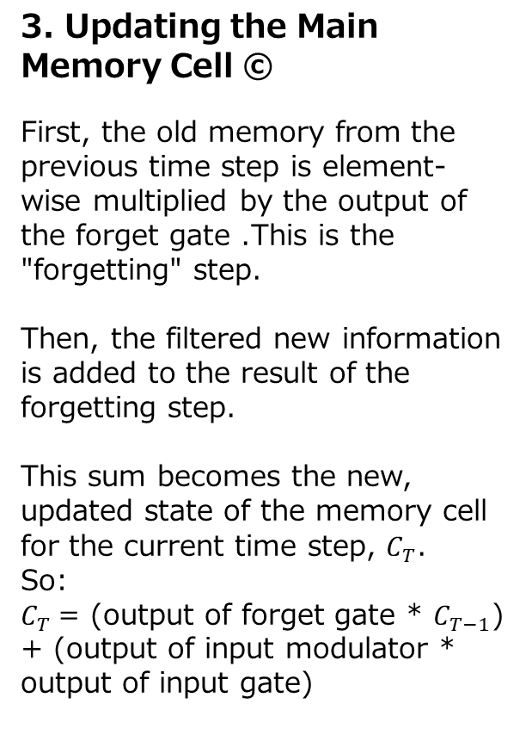
Decoder: The LSTM Architecture
3. Updating the Main Memory Cell ©
First, the old memory from the previous time step is element-wise multiplied by the output of the forget gate .This is the "forgetting" step.
Then, the filtered new information is added to the result of the forgetting step.
This sum becomes the new, updated state of the memory cell for the current time step, $C_{T}$.
So:
$C_{T}$= (output of forget gate * $C_{T−1}$) + (output of input modulator * output of input gate)

Slide 40
Decoder: The LSTM Architecture
4. Preparing the Output for this Time Step:
a. Output Gate :
The inputs are put into the "output gate“ and then calculates a filter.

Slide 41
Decoder: The LSTM Architecture
4. Preparing the Output for this Time Step:
a. Output Gate :
The inputs are put into the "output gate“ and then calculates a filter.
b. Processing the Updated Memory for Output:
The content of the updated memory cell is passed through a tanh function. This scales the memory content to a range between -1 and 1.

Slide 42
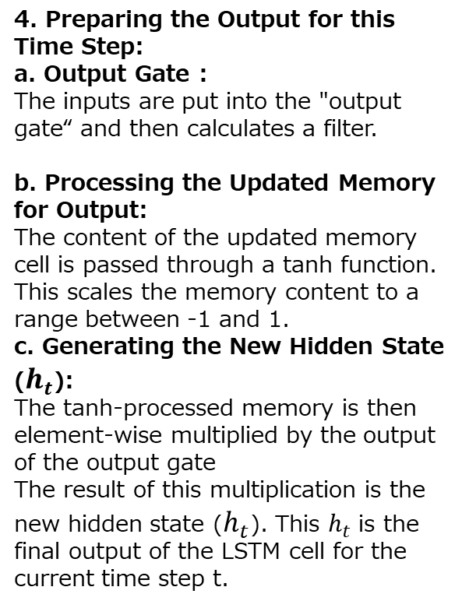
Decoder: The LSTM Architecture
4. Preparing the Output for this Time Step:
a. Output Gate :
The inputs are put into the "output gate“ and then calculates a filter.
b. Processing the Updated Memory for Output:
The content of the updated memory cell is passed through a tanh function. This scales the memory content to a range between -1 and 1.
c. Generating the New Hidden State ($h_{t}$):
The tanh-processed memory is then element-wise multiplied by the output of the output gate
The result of this multiplication is the new hidden state ($h_{t}$). This $h_{t}$is the final output of the LSTM cell for the current time step t.

Slide 43
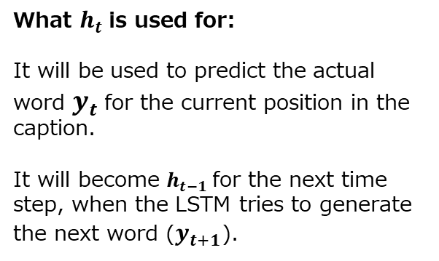
Decoder: The LSTM Architecture
What $h_{t}$is used for:
It will be used to predict the actual word $y_{t}$for the current position in the caption.
It will become $h_{t−1}$for the next time step, when the LSTM tries to generate the next word ($y_{t+1}$).

Slide 44
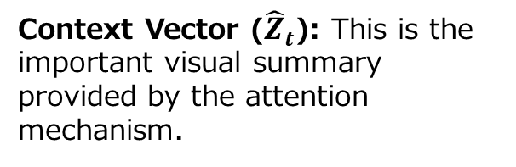
Decoder: The LSTM Architecture
Context Vector (${\hat{Z}}_{t}$​): This is the important visual summary provided by the attention mechanism.

Slide 45
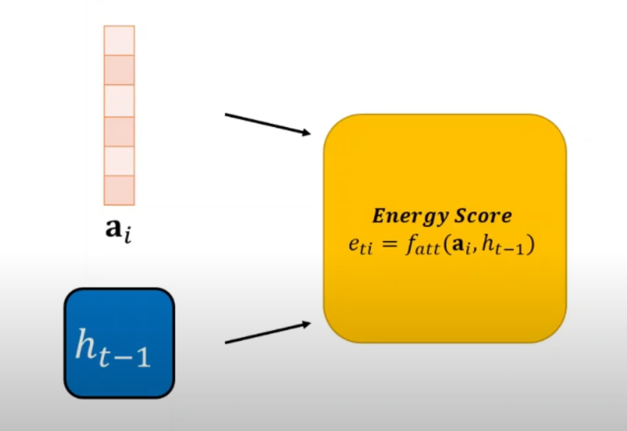
How is context vector calculated?

Slide 46
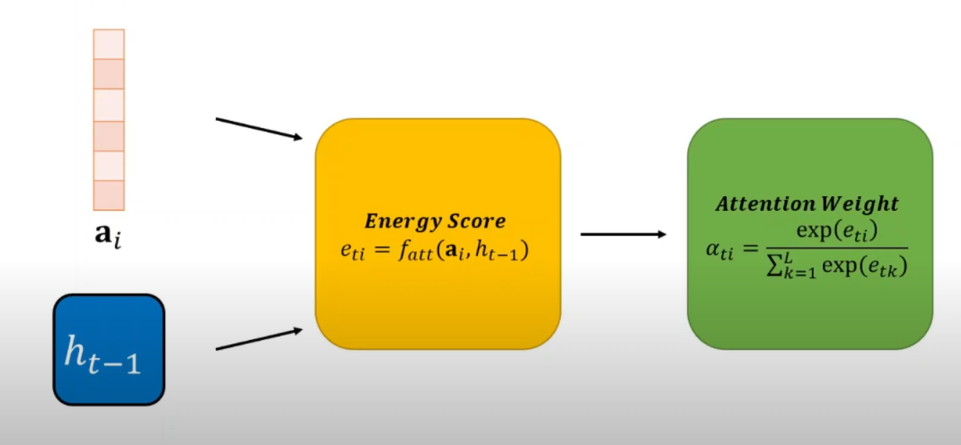
How is context vector calculated?

Slide 47
How is context vector calculated?
MLP

Slide 48
How is context vector calculated?
MLP
Softmax

Slide 49
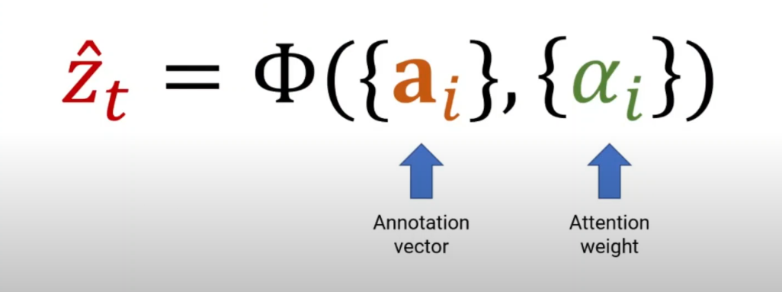
How is context vector calculated?

Slide 50
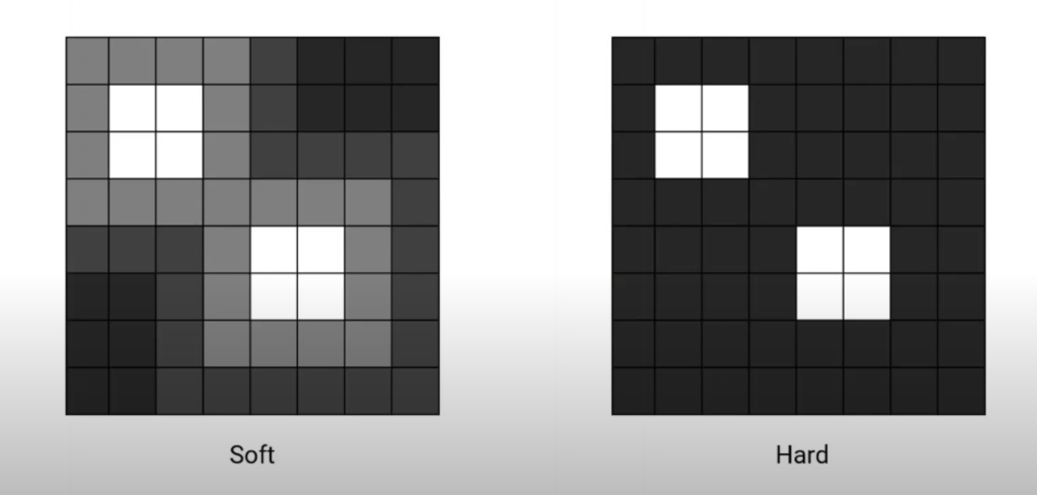
Hard and soft attention

Slide 51
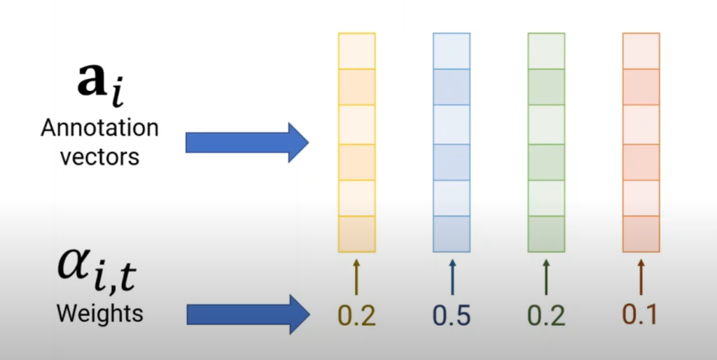
Hard and soft attention

Slide 52
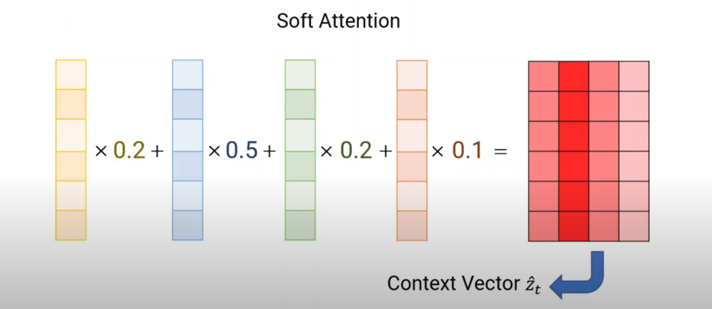
Hard and soft attention

Slide 53
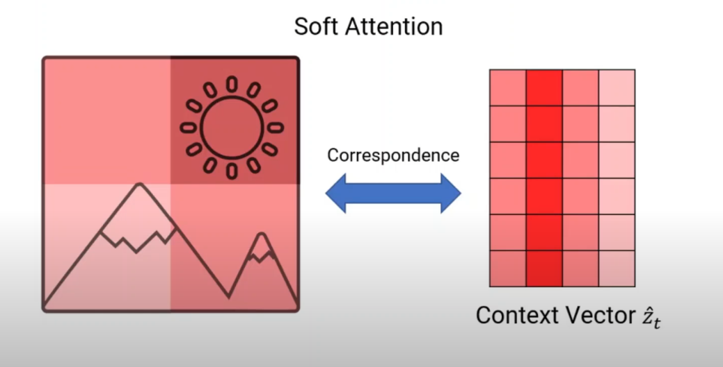
Hard and soft attention

Slide 54
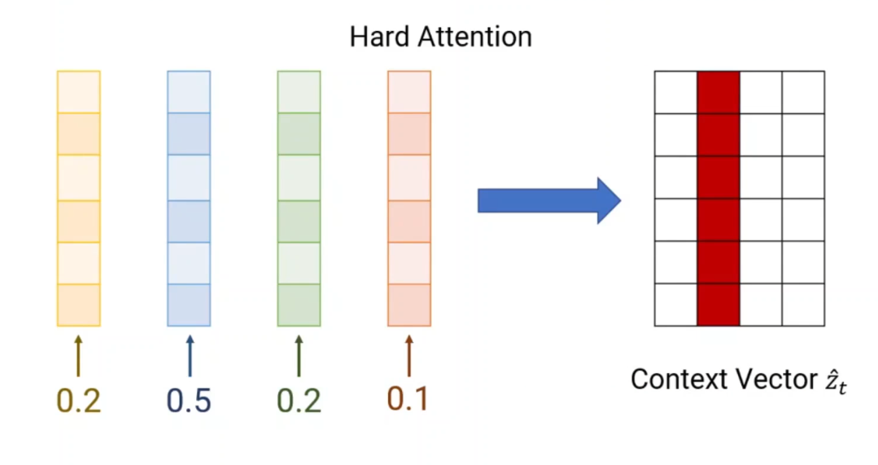
Hard and soft attention

Slide 55
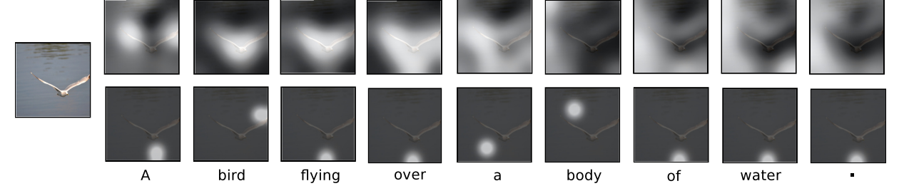
Hard and soft attention
Soft
Hard

Slide 56
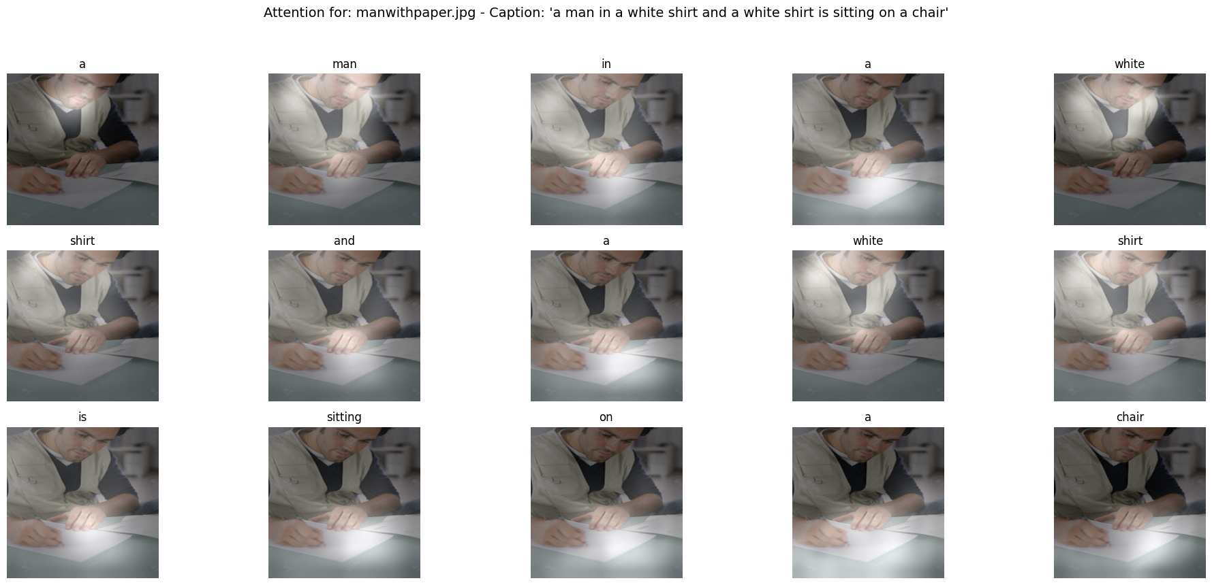
How Beam Search Works
Goal: Convert an image into a coherent and descriptive text caption.
The model:
CNN: Extracts visual features from the image.
LSTM: Generates words one by one, using these features and its internal memory.
The Problem: At each step, the LSTM outputs probabilities for thousands of possible next words. How do we choose the best sequence of words to form the entire caption?

Slide 57
How Beam Search Works
Easiest approach: At each step, simply pick the word with the highest probability.
Step 1: Predicts "A" (prob=0.9)
Step 2: Predicts "dog" (prob=0.8)
Step 3: Predicts "is" (prob=0.7)
...
Caption: "A dog is running in the park."
Why it can fail: A locally optimal choice (the highest probability word at one step) doesn't always lead to a globally optimal (best overall) sentence.
Example: "A dog is running" might seem best now, but "A very cute dog is running" might have been achievable if we hadn't been so "greedy" early on.

Slide 58
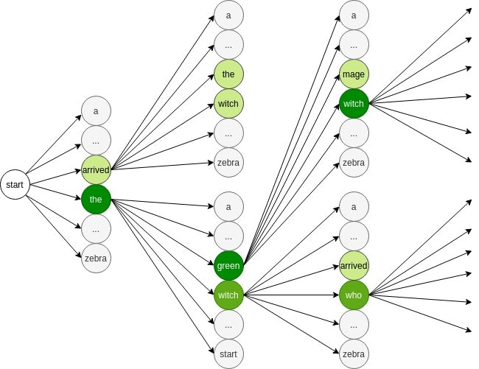
How Beam Search Works
Beam search approach: Instead of just picking the single best word at each step, Beam Search explores multiple promising partial sequences (hypotheses) simultaneously

Slide 59
How Beam Search Works
Beam search approach: Instead of just picking the single best word at each step, Beam Search explores multiple promising partial sequences (hypotheses) simultaneously
The "Beam Size" Parameter (k)
Definition: k is the maximum number of partial sequences (hypotheses) that Beam Search keeps track of at each step.
Impact of k:
k=1: This is equivalent to Greedy Search.
Small k (2-5): Explores a few options.
Large k (5-35): Explores a wider range of options.

Slide 60
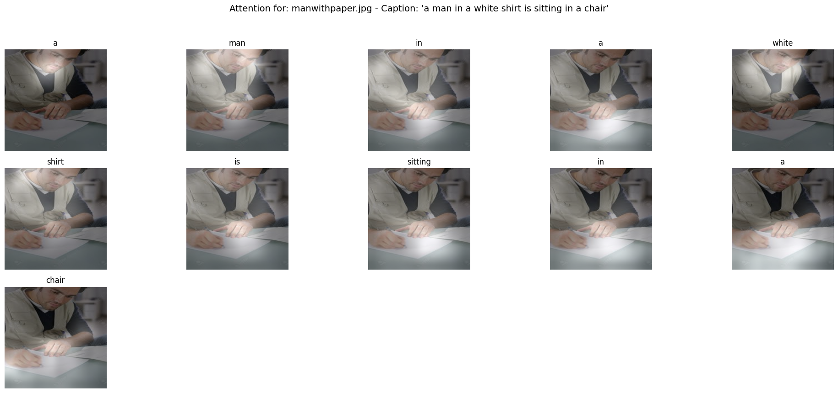
How Beam Search Works
Beam search approach: Instead of just picking the single best word at each step, Beam Search explores multiple promising partial sequences (hypotheses) simultaneously
a man in a white shirt and a white shirt is sitting on a chair
a man in a white shirt is sitting in a chair
Beam Size: 35
Beam Size: 5
Beam Size: 35

